Slide 1
Career & TeCH Education (CTE) National Program Strategy
Linda Nelson
CTE & WFR Program Manager
Jim Rosen
Global Training Staff Manager

Slide 2
Where we are….where we are going
AGENDA
Wins – Local CTE Program executed
National Program
Industry standard certification – Heavy Duty Turbine
Mechanic

Slide 3
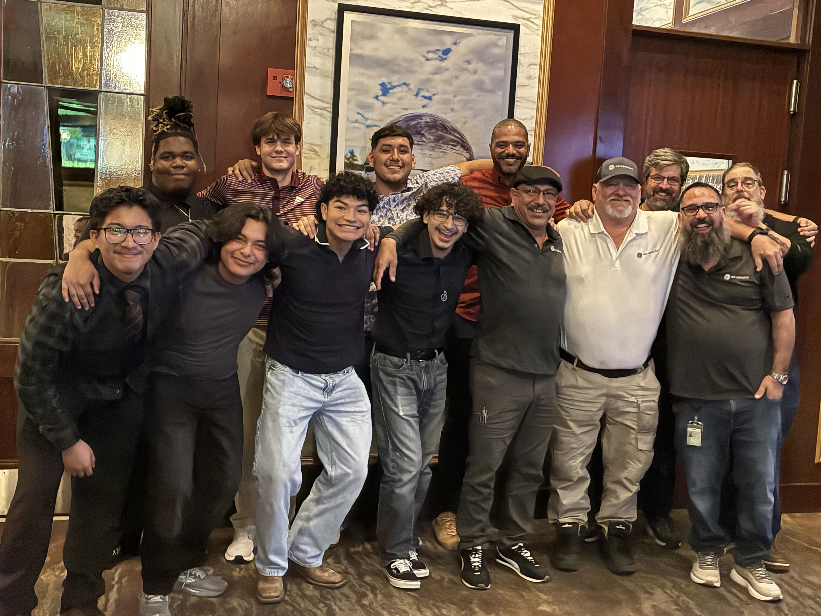
WINS
Summer Skills Camp
7 recently graduated seniors
Attended month of July
Completed MA GT Fundamental & Hot Gas Path
course score 81% - 93%
6 recommended for hire, 6 interviewed and accepted (vet out)
Fall CTE Cohort
Start at HLC 9/1
6 Hours a week
18 students
3 local school districts
Complete MA GT Accelerated May 27’
Level 1 text
Level 2 text
Level 3 text
Level 4 text

Slide 4
VALIDATED
Career & Tech Education (CTE) pathways in high school are a valuable resource to inform and contribute to our Workforce Readiness needs, related to entry level craft positions.

Slide 5
NATIONAL CTE STRATEGY
Content & Curriculum
Location & Partners
GEV Benefit

Slide 6


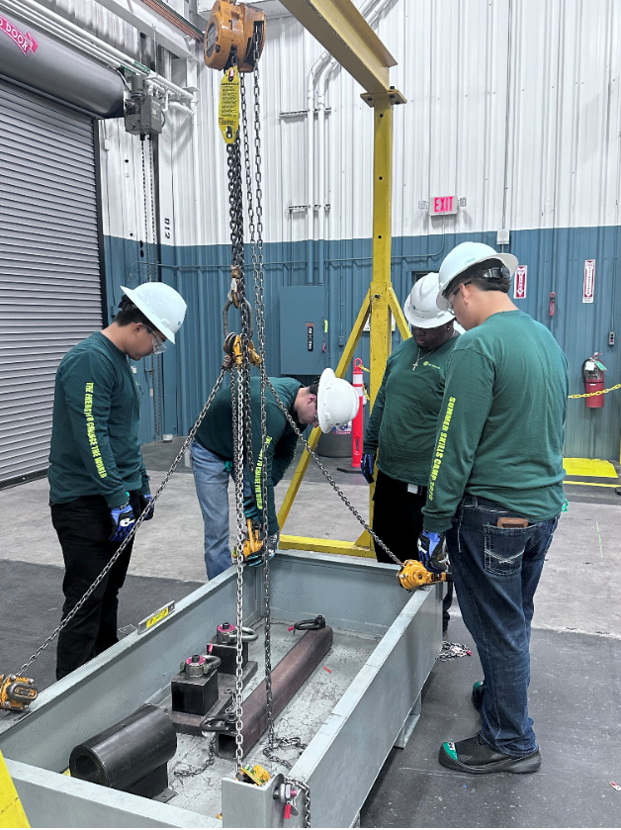
Content & Curriculum
Mechanic Assistant
Hands on Fundamentals
5-week MA Accelerated GT
1- week on boarding
2-weeks hands on
fundamental/theory
2- weeks outage
Amatol
GE Vernova Plan
XALTER
GEV Proof of Concept
Clicko add text column.

Slide 7



Location & Partners
Clicko add text column.
School Districts
West Texas
Louisa County Schools – VA
Pennsylvania
Tech School
ARC
Business Partners
Decommissioned Assets

Slide 8
GEV Benefit
Compensation (national)
$3520 MA employee
2 Week pay/per diem
$211,200 annually (3X20)
Local CTE - 5-Week
$10,180 pay/per diem
$183,400 annually (18)
HLC space
Instructor time x 3
80 HRS x$120 = $28,800
New pool of talent
Time to hire
Ability to vet
Retention rate
Reduced risk

Slide 9
Industry Standard Certifiation

Slide 10
SACA
Strategic Certification Roadmap - Heavy Duty Turbine Mechanic
GEV SME informs knowledge skills
Opportunity for funding/grants
School partner benefit, accountablity

Slide 11
What we Need?

Slide 12
INVESTMENT
APROVAL & ADVISMENT
- Exploratory conversations with national school districts
- Share Decomissioned Asset PPT with customers
- Legal contact for items such as logo use, commitment to job opportunities
- Pursue the possibility of national certification Heavy Duty Turbine Mechanic
Content Development
XALTER (CTE & Internal use)
600,000 – 1M
(possible funding w/ partners grants)
SACA
National Certification & Testing Facility
400,000 – 1M

